Slide 1
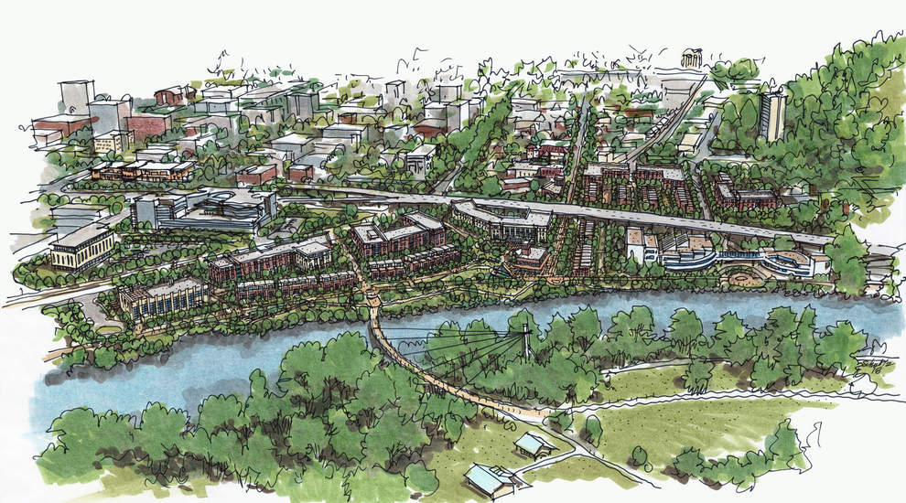
Using the Collective Impact Framework
& Adaptive Management Techniques to Promote
More Effective and Widespread Green Infrastructure
Credit: SERA Architects
Scott Altenhoff – City of Eugene – Urban Forestry
Notes:
Intro: Traditional Grey Infrastructure approach is like a Pot roast w/ parlsey garnish vs. GI approach (a robust and healthful salad with a bit of meat to complement it).

Slide 2
What is Green Infrastructure?
Notes:
It never hurts to define our terms.

Slide 3
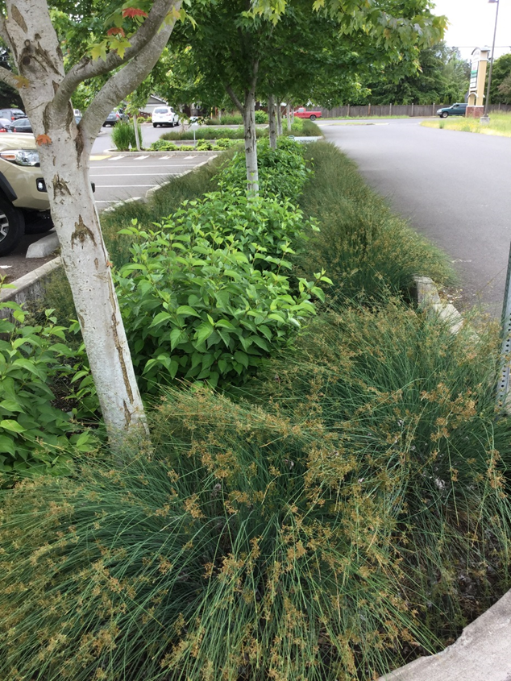
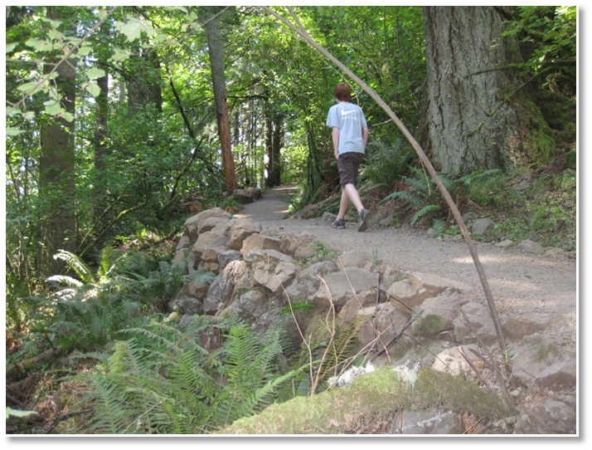
Photo : Sequential Biofuels
Photo: Fred Lockhart
Photo: Eugene Parks &Open Space

Slide 4
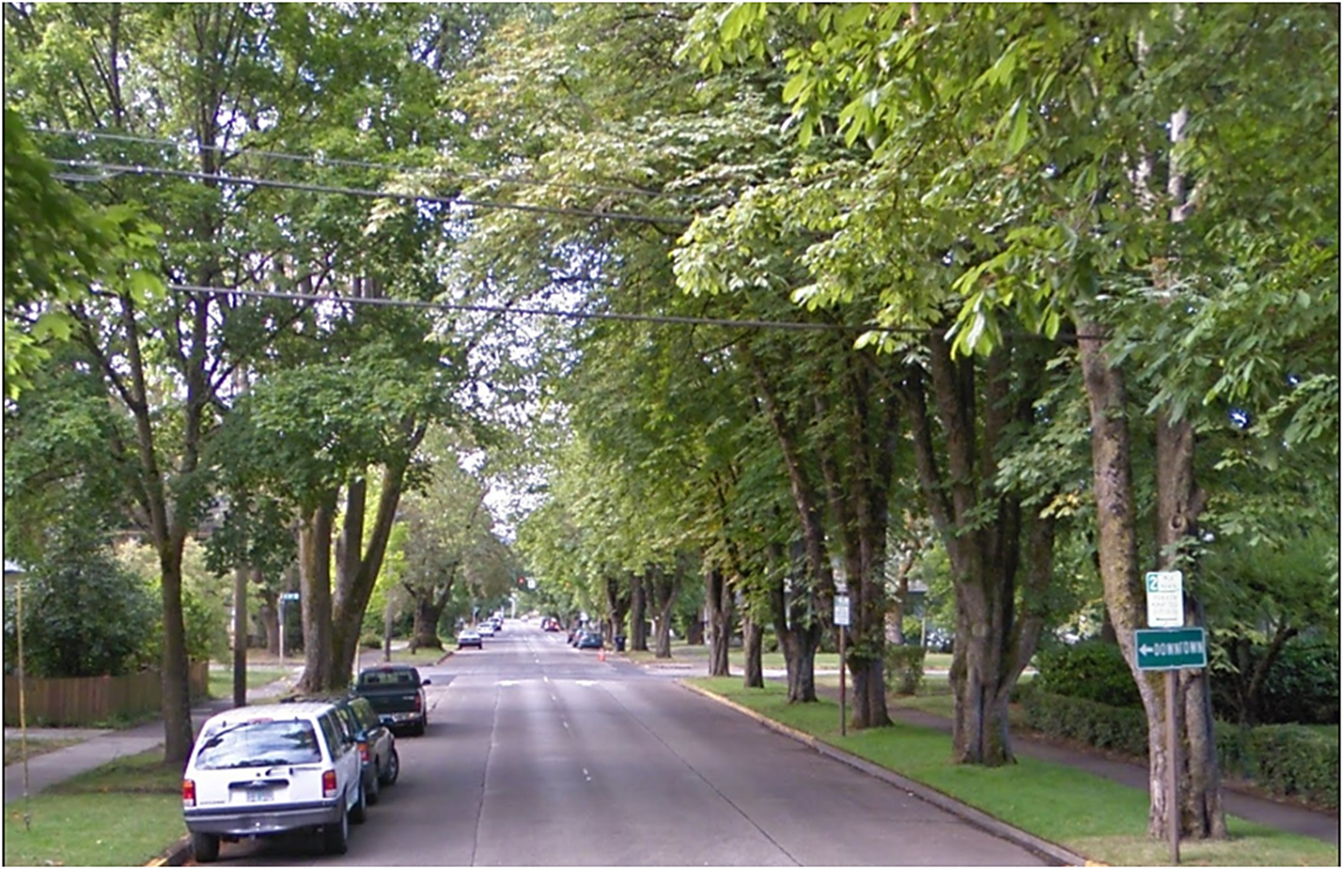
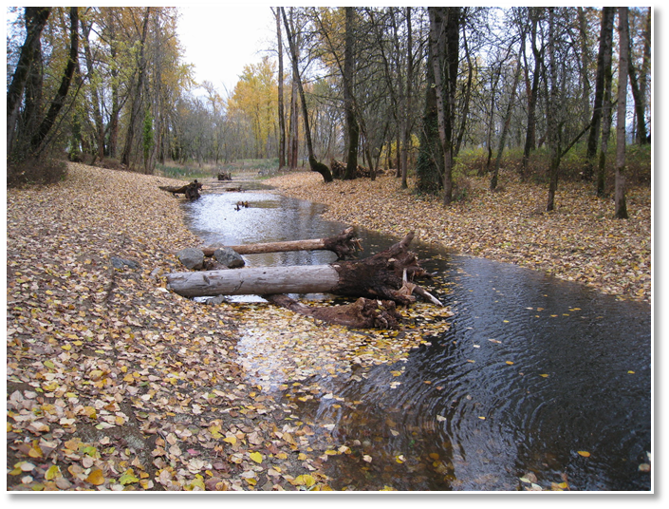
Photo: Google Maps
Photo: Eugene Parks &Open Space

Slide 5
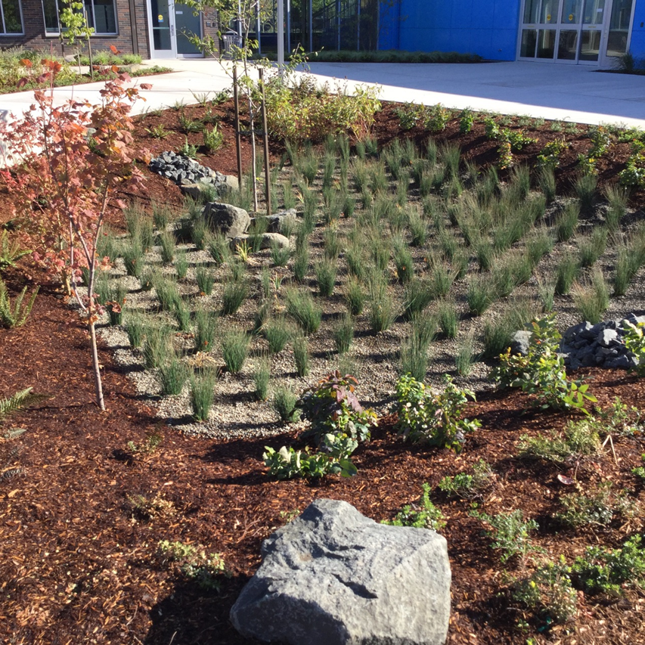
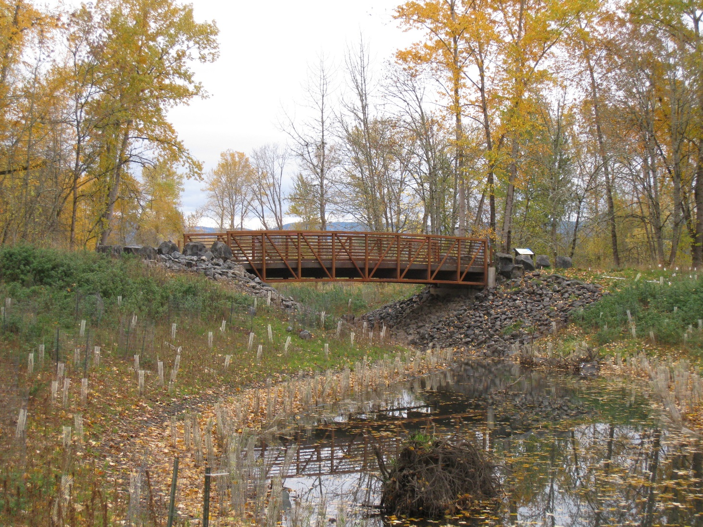
Photo: Eugene Parks &Open Space
Photo: Fred Lockhart

Slide 6
What is Green Infrastructure?
“Green infrastructure is more than a bioswale or a green roof or a forested corridor – it’s a different way of thinking about infrastructure.”
-Greening the Grey: An Institutional Analysis of Green Infrastructure for Sustainable Development in the US
Notes:
It never hurts to define our terms.

Slide 7
What is Green Infrastructure?
“Green infrastructure is more than a bioswale or a green roof or a forested corridor – it’s a different way of thinking about infrastructure.
Understood as a multi-­scale network of ecological features and systems that provide multiple functions and benefits, GI provides a systems approach to planning and development that recognizes the value of ecosystem services and strives to integrate and enhance those ecosystem services within our built environment.”
-Greening the Grey: An Institutional Analysis of Green Infrastructure for Sustainable Development in the US

Slide 8
What is Green Infrastructure?
“Green infrastructure is not limited to a particular type of technology or feature doing a specific job”
-Greening the Grey: An Institutional Analysis of Green Infrastructure for Sustainable Development in the US

Slide 9
What is Green Infrastructure?
“Green infrastructure is not limited to a particular type of technology or feature doing a specific job;
it’s the result of a wide network of institutions, organizations, agencies, businesses, and citizens bringing ecosystem services back into planning and development.”
-Greening the Grey: An Institutional Analysis of Green Infrastructure for Sustainable Development in the US
Notes:
As a network the whole is in many ways only as strong as it’s weakest link.

Slide 10
What is Green Infrastructure?
“Green infrastructure is not limited to a particular type of technology or feature doing a specific job;
it’s the result of a wide network of institutions, organizations, agencies, businesses, and citizens bringing ecosystem services back into planning and development.
It’s ultimately about people and organizations making that choice.”
-Greening the Grey: An Institutional Analysis of Green Infrastructure for Sustainable Development in the US
Notes:
It never hurts to define our terms.

Slide 11
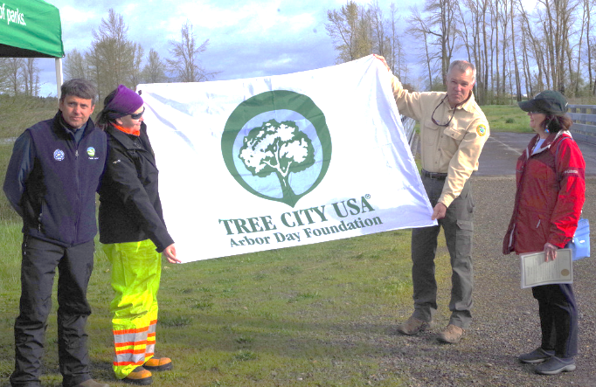
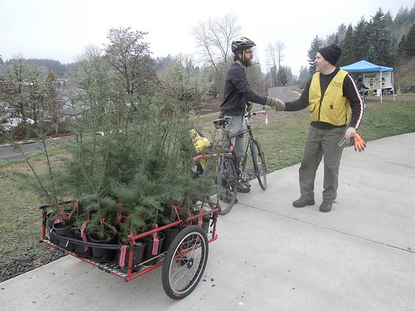
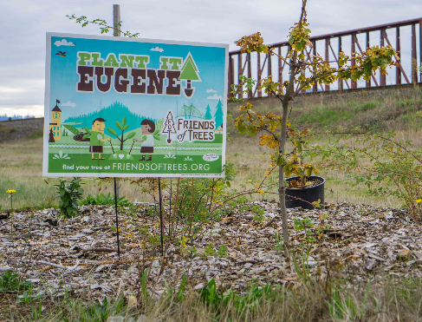
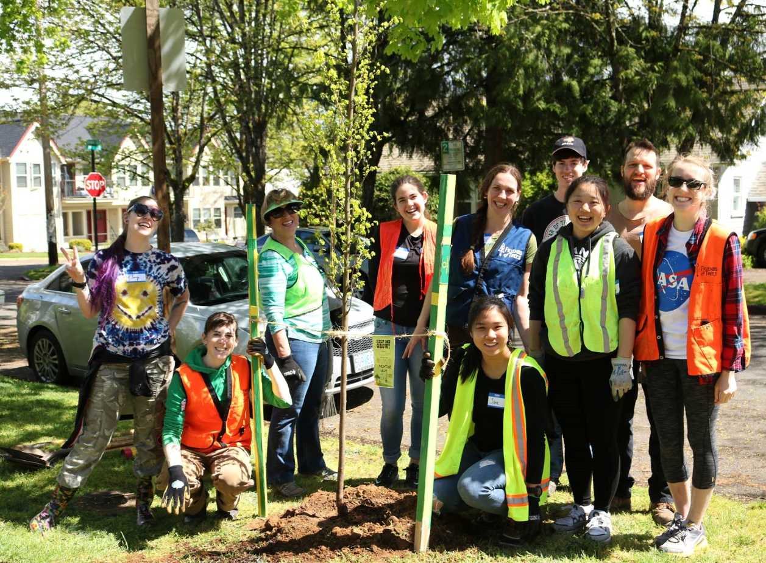
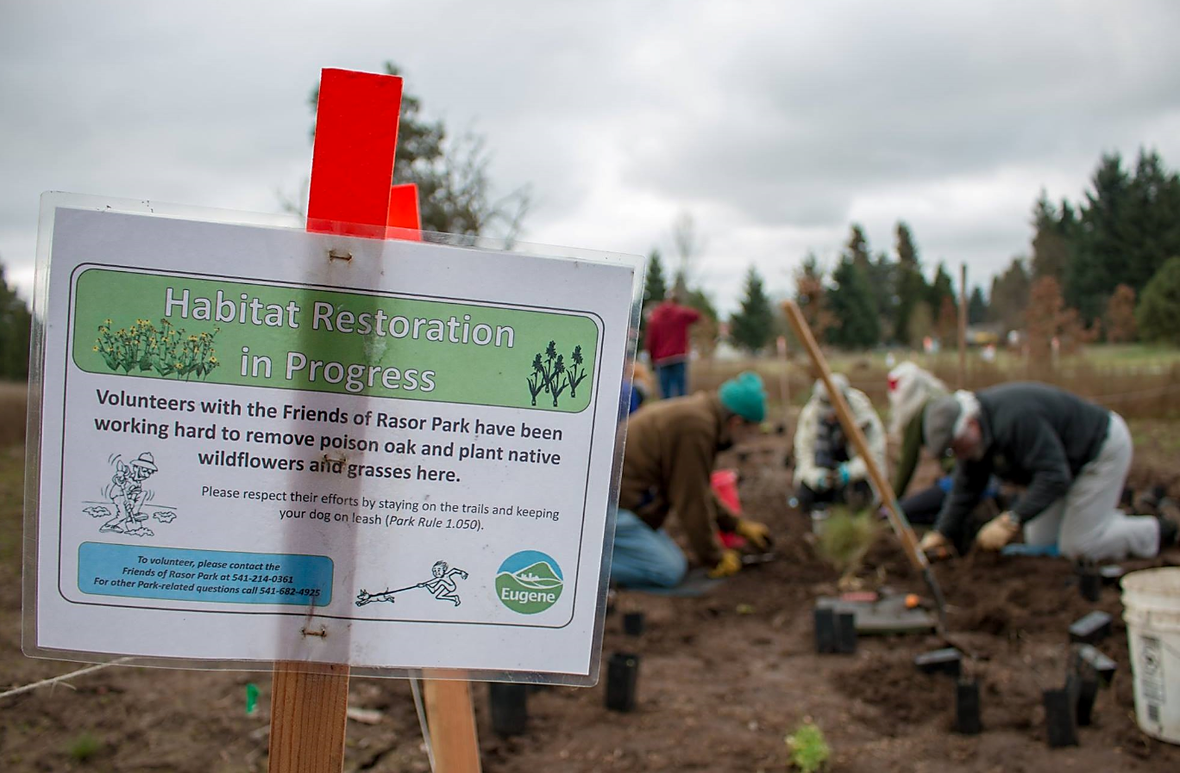
Photo: Worlfram Burner
Photo: Friends of Trees
Photo: Friends of Trees
Photo: Eugene Parks &Open Space
Notes:
Describe the various partners we work with to promote GI: U of O, OSU, PSU, WSU, local schools, FOT, LTWC, LCOG, MRT, LA’s, Architects, Builders, Developers, Other departments, etc.

Slide 12
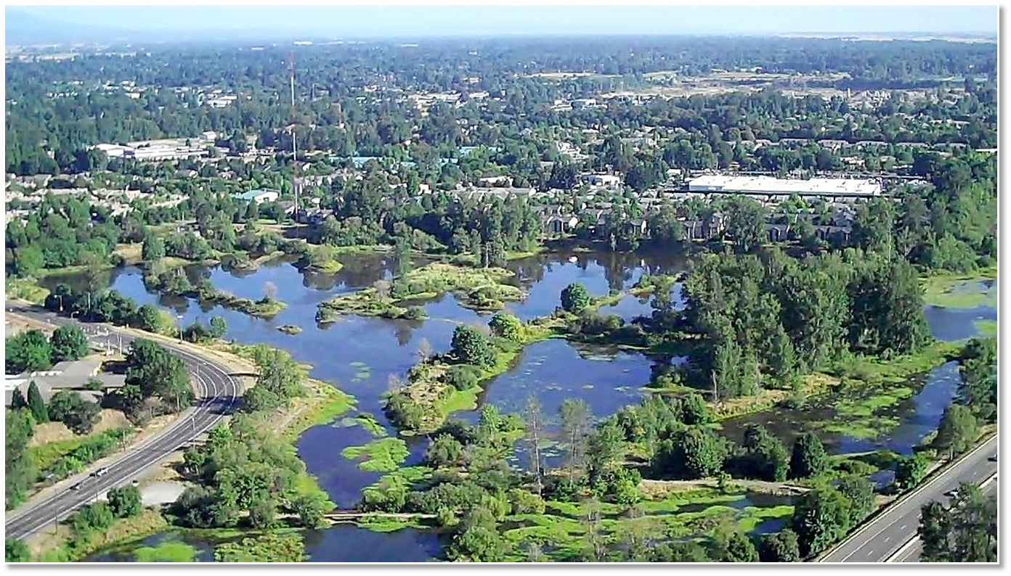
A Prime Example of Green Infrastructure in Eugene
Photo: Raptor Views Aerial Imaging
Notes:
150-site in the heart of Eugene. It is great example of a successful GI project. Approximately 10 million restoration project involving 2.2 miles of side-channel. Former gravel mines

Slide 13
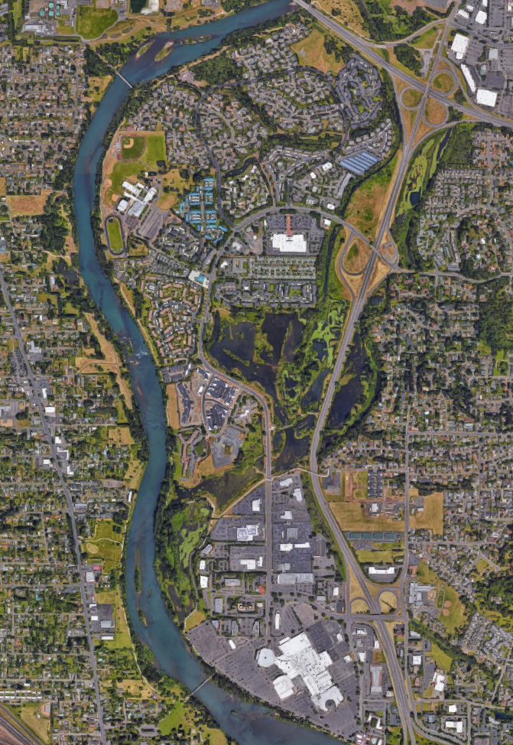
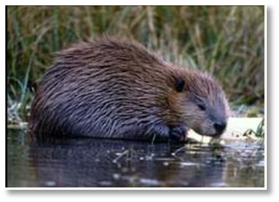
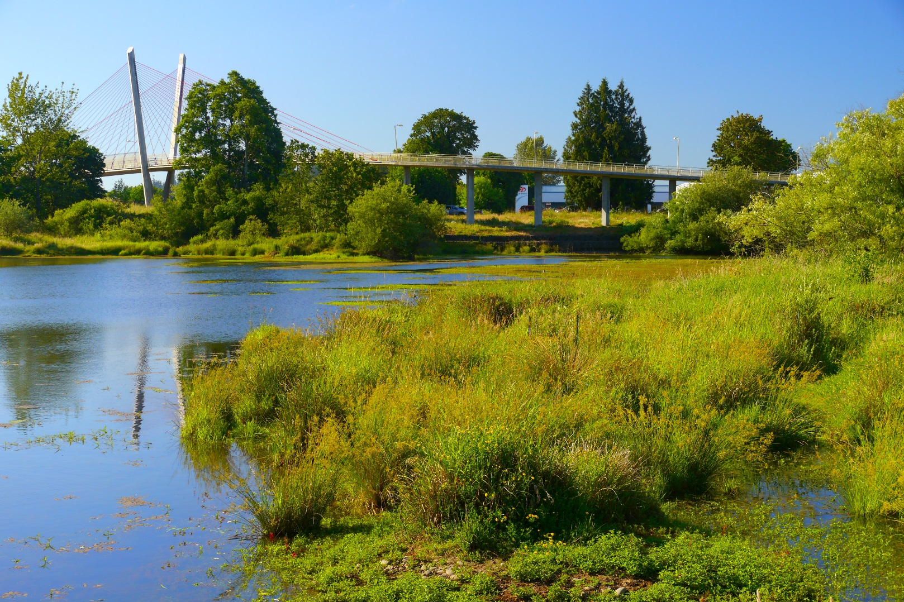
Multi-functionality
Image: Google Maps
Photo by Rick Obst
Notes:
150-site in the heart of Eugene. It is great example of a successful GI project. Approximately 10 million restoration project involving 2.2 miles of side-channel. Former gravel mines

Slide 14
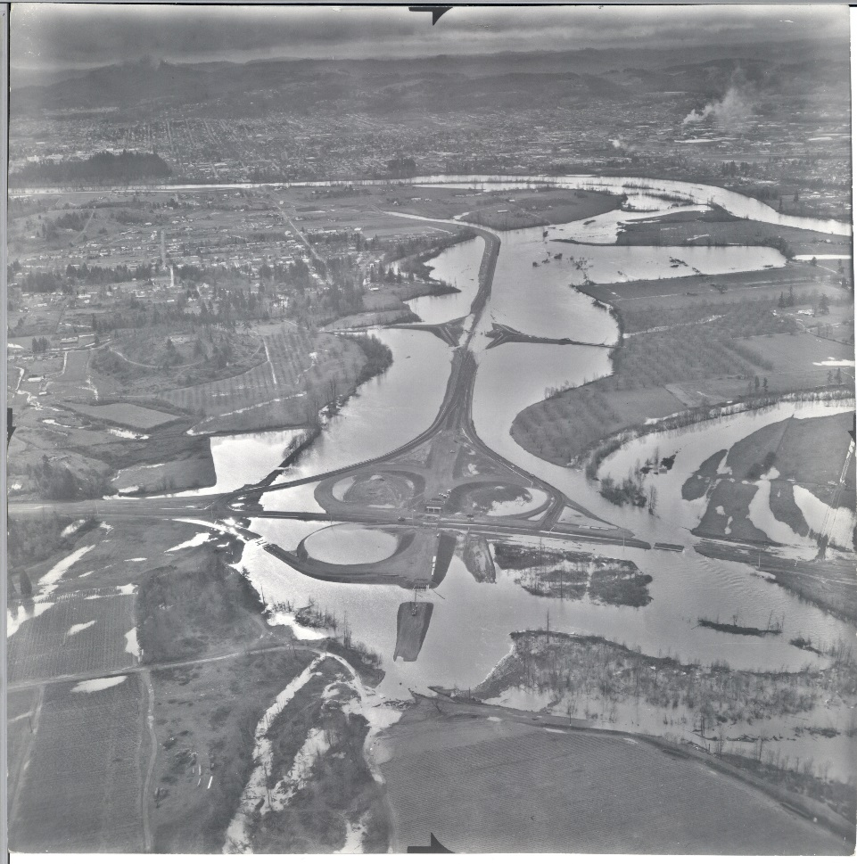
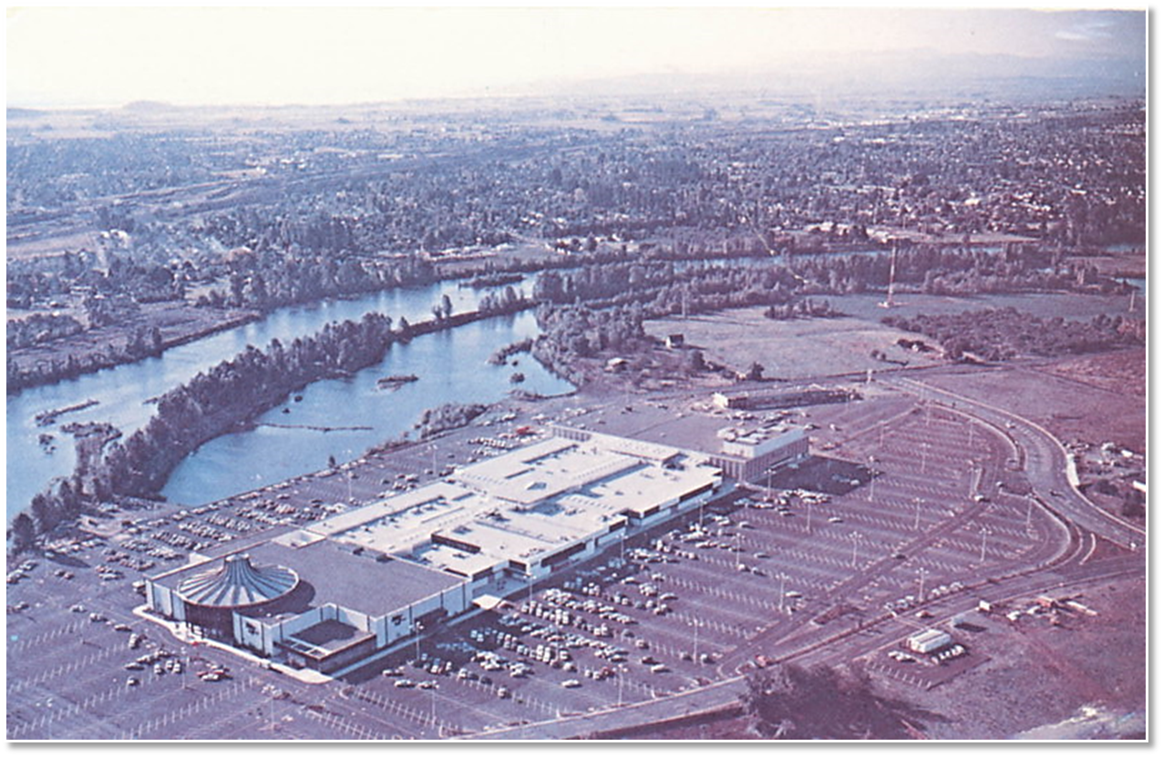
Helping to turn community liabilities into assets
Photo: Malls of America Blog
Photo: Eugene Parks and Open Space

Slide 15
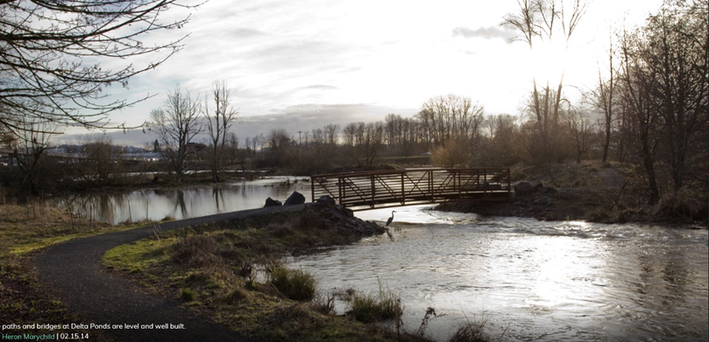
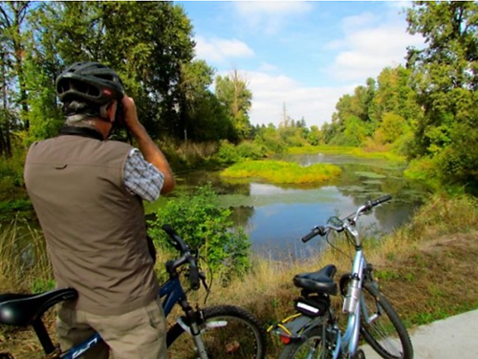
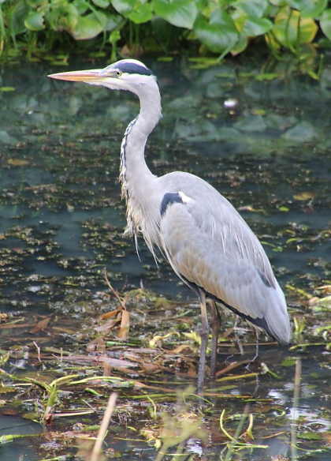
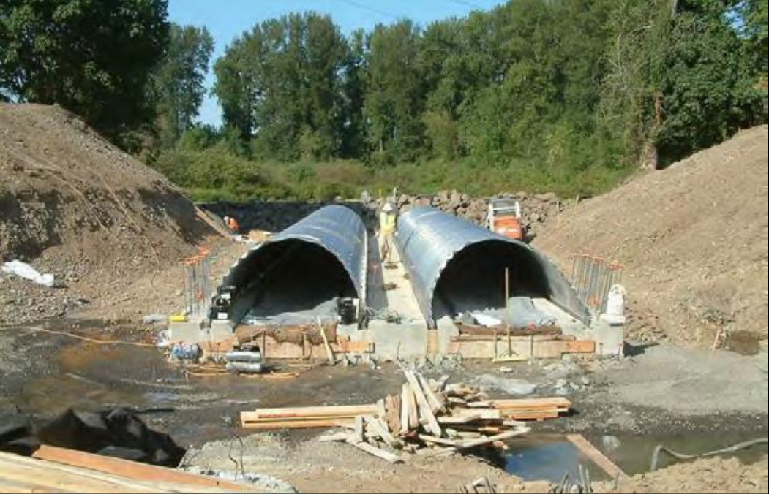
A broad array
of partners and stakeholders
Photo Credit: Chickadee and Raven
Photo: Eugene Parks &Open Space

Slide 16
TODAY’S OBJECTIVES:
Notes:
I strongly suspect that you all are well aware of the benefits of GI and some of the challenges (that’s why we’re all here) but it never hurts to review and reframe concepts and make certain we’re all on the same page.

Slide 17
TODAY’S OBJECTIVES:
To quickly clarify the benefits and challenges of Green Infrastructure
Notes:
I strongly suspect that you all are well aware of the benefits of GI and some of the challenges (that’s why we’re all here) but it never hurts to review and reframe concepts and make certain we’re all on the same page.

Slide 18
TODAY’S OBJECTIVES:
To quickly clarify the benefits and challenges of Green Infrastructure
To provide a brief summary of the Collective Impact framework

Slide 19
TODAY’S OBJECTIVES:
To quickly clarify the benefits and challenges of Green Infrastructure
To provide a brief summary of the Collective Impact framework
To provide a brief summary of Adaptive Management principles

Slide 20
TODAY’S OBJECTIVES:
To quickly clarify the benefits and challenges of Green Infrastructure
To provide a brief summary of the Collective Impact framework
To provide a brief summary of Adaptive Management principles
To initiate a discussion about how we might better use these two concepts to improve and expand our region’s GI network

Slide 21
Potential Green Infrastructure Benefits

Slide 22
Potential Green Infrastructure Benefits
Improved ecosystem functioning and services

Slide 23
Potential Green Infrastructure Benefits
Improved ecosystem functioning and services
Improved resilience to natural disasters/disturbances

Slide 24
Potential Green Infrastructure Benefits
Improved ecosystem functioning and services
Improved resilience to natural disasters/disturbances
Improved community health (mental and physical)

Slide 25
Potential Green Infrastructure Benefits
Improved ecosystem functioning and services
Improved resilience to natural disasters/disturbances
Improved community health (mental and physical)
Improved economic vitality

Slide 26
Potential Green Infrastructure Benefits
Improved ecosystem functioning and services
Improved resilience to natural disasters/disturbances
Improved community health (mental and physical)
Improved economic vitality
Enhanced opportunities for recreation, tourism, and alternative transportation

Slide 27
Potential Green Infrastructure Benefits
Improved ecosystem functioning and services
Improved resilience to natural disasters/disturbances
Improved community health (mental and physical)
Improved economic vitality
Enhanced opportunities for recreation, tourism, and alternative transportation
Improved community aesthetics and livability

Slide 28
Potential Green Infrastructure Benefits
Improved ecosystem functioning and services
Improved resilience to natural disasters/disturbances
Improved community health (mental and physical)
Improved economic vitality
Enhanced opportunities for recreation, tourism, and alternative transportation
Improved community aesthetics and livability
Energy conservation and reduced waste

Slide 29
Potential Green Infrastructure Benefits
Improved ecosystem functioning and services
Improved resilience to natural disasters/disturbances
Improved community health (mental and physical)
Improved economic vitality
Enhanced opportunities for recreation, tourism, and alternative transportation
Improved community aesthetics and livability
Energy conservation and reduced waste
The real key to GI is its multi-functionality and
its ability to work with - rather than against - natural processes
Notes:
GI’s cost-effectiveness derives from multi-functionality and taking advantage of nature’s regenerative abundance. GI is like mother nature’s Ginsu knife – but wait there’s more! Especially when trees are involved GI can appreciate in value over time.

Slide 30
Green Infrastructure Challenges

Slide 31
Green Infrastructure Challenges
Our current challenges with GI tend to be more cultural than technical

Slide 32
Green Infrastructure Challenges
Our current challenges with GI tend to be more cultural than technical
The major barriers seem to involve complex or “wicked” problems rather than complicated or “tame” problems

Slide 33
Green Infrastructure Challenges
Our current challenges with GI tend to be more cultural than technical
The major barriers seem to involve complex or “wicked” problems rather than complicated or “tame” problems
It appears that the most significant problems are related to a general lack of coordination and “information flow” among partners and stakeholders

Slide 34
Green Infrastructure Challenges
Ignorance, apathy, time pressures, convention

Slide 35
Green Infrastructure Challenges
Ignorance, apathy, time pressures, convention
Limited understanding of true costs, benefits and general performance of Green vs. Grey Infrastructure

Slide 36
Green Infrastructure Challenges
Ignorance, apathy, time pressures, convention
Limited understanding of true costs, benefits and general performance of Green vs. Grey Infrastructure
Low risk tolerance (people are willing to forego unknown opportunities if they think they are more certain to avoid known threats)

Slide 37
Green Infrastructure Challenges
Ignorance, apathy, time pressures, convention
Limited understanding of true costs, benefits and general performance of Green vs. Grey Infrastructure
Low risk tolerance (people are willing to forego unknown opportunities if they think they are more certain to avoid known threats)
Mandates to implement GI projects with limited support or resources to properly maintain these projects (O&M shortfall)

Slide 38
Green Infrastructure Challenges
Ignorance, apathy, time pressures, convention
Limited understanding of true costs, benefits and general performance of Green vs. Grey Infrastructure
Low risk tolerance (people are willing to forego unknown opportunities if they think they are more certain to avoid known threats)
Mandates to implement GI projects with limited support or resources to properly maintain these projects (O&M shortfall)
Lack of interaction/conflicting agendas among key stakeholders resulting in social network fragmentation

Slide 39
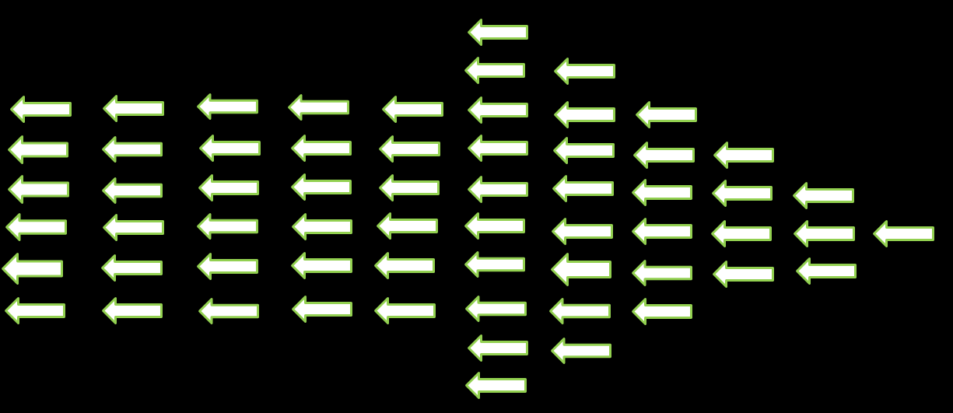
“Culture Eats Strategy for Breakfast”
-Peter Drucker
Backward
Forward

Slide 40
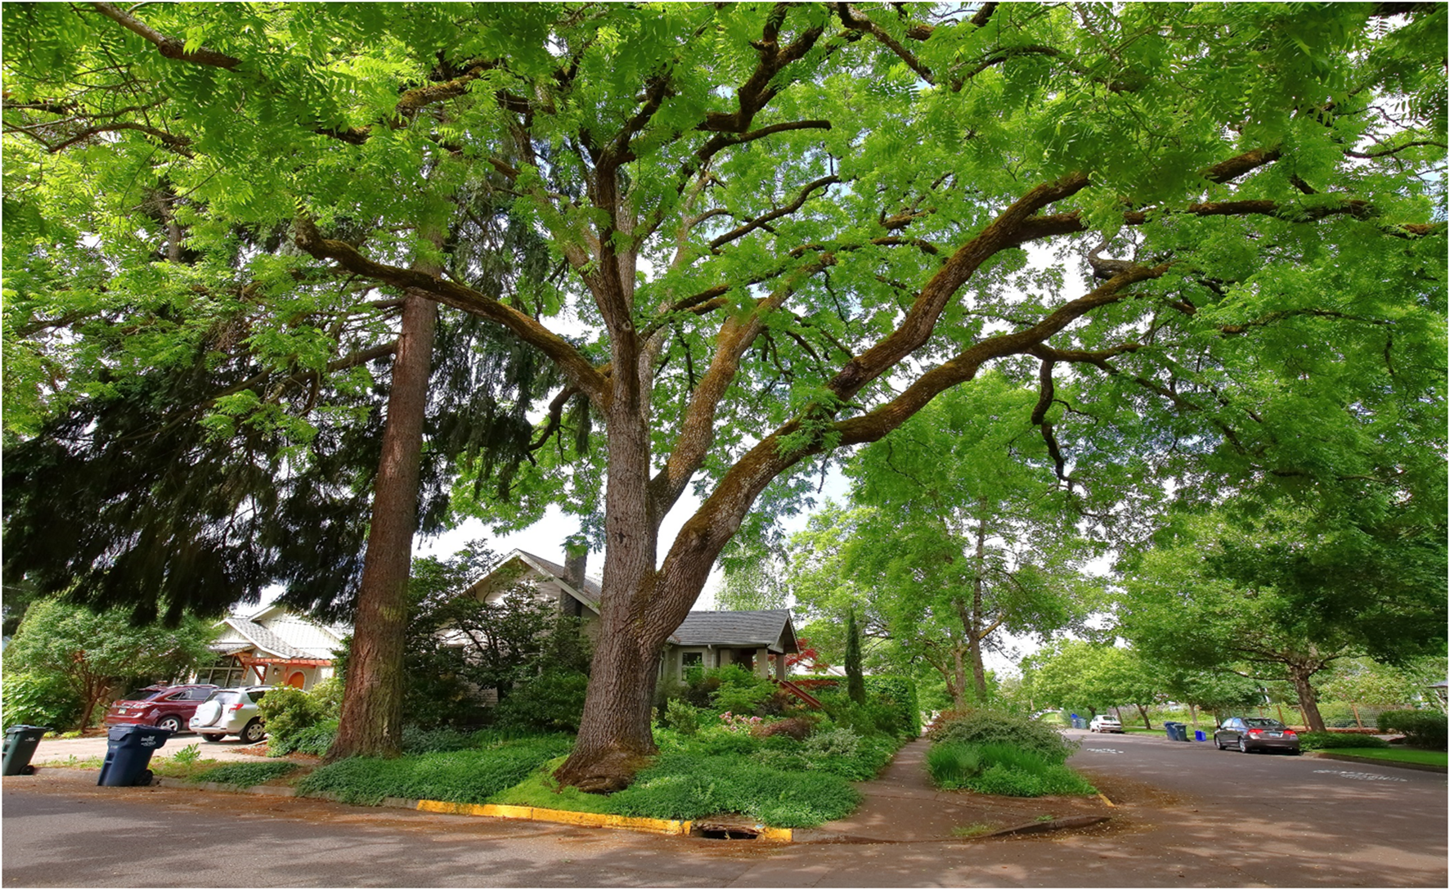
Photo: Eric DeBord

Slide 41
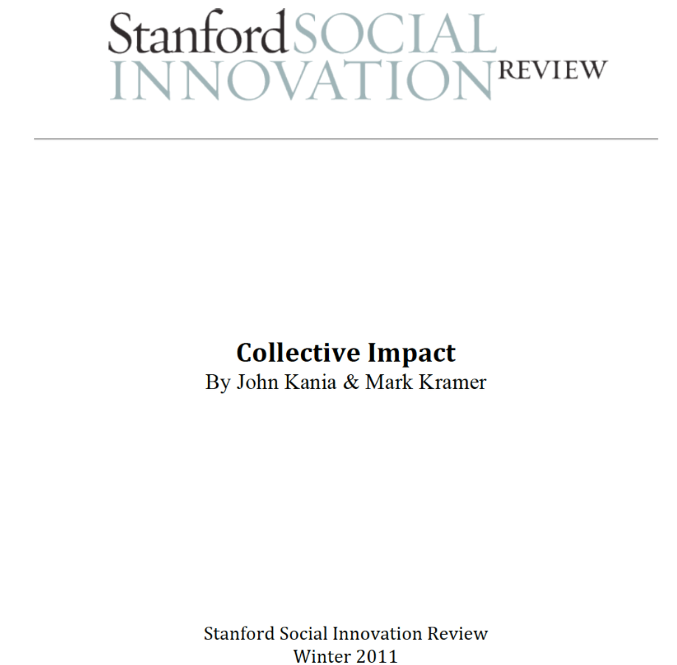
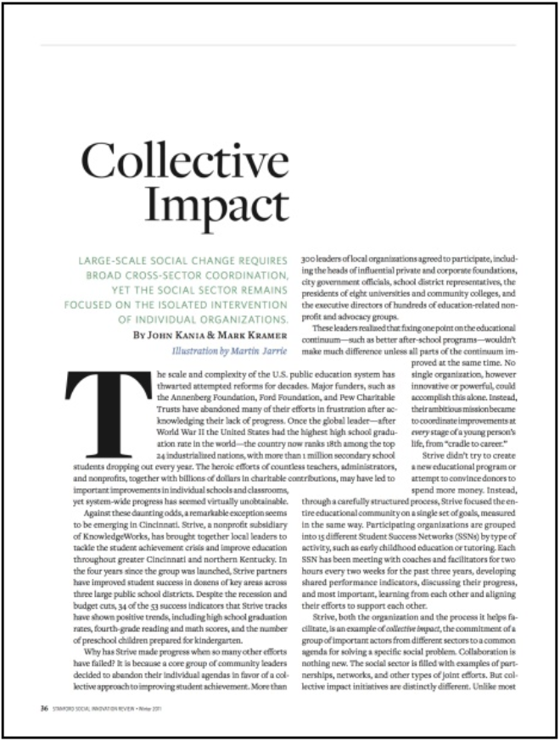
The Collective Impact Framework
Notes:
It’s remarkable that such an ancient concept, basically that of a confederation (as in the ancient Greek city-states), could be the topic of a compelling, let alone revolutionary article. But it does reframe and clarify some essential points that can greatly benefit our work.

Slide 42
Different Types of Group Impact
Unaligned
(isolated)
Impact
Collaborative
Impact
Collective
Impact

Slide 43
The Collective Impact Framework
Common Agenda
Shared Measurement
Mutually Reinforcing Activities
Continuous Communication
Backbone Support

Slide 44
The Collective Impact Framework
Common Agenda
Common understanding of the problem
Shared vision for change
Shared Measurement
Mutually Reinforcing Activities
Continuous Communication
Backbone Support

Slide 45
The Collective Impact Framework
Common Agenda
Common understanding of the problem
Shared vision for change
Shared Measurement
Collecting data and measuring results
Focus on performance management
Shared accountability
Mutually Reinforcing Activities
Continuous Communication
Backbone Support

Slide 46
The Collective Impact Framework
Common Agenda
Common understanding of the problem
Shared vision for change
Shared Measurement
Collecting data and measuring results
Focus on performance management
Shared accountability
Mutually Reinforcing Activities
Differentiated approaches
Coordination through joint plan of action
Continuous Communication
Backbone Support

Slide 47
The Collective Impact Framework
Common Agenda
Common understanding of the problem
Shared vision for change
Shared Measurement
Collecting data and measuring results
Focus on performance management
Shared accountability
Mutually Reinforcing Activities
Differentiated approaches
Coordination through joint plan of action
Continuous Communication
Consistent and open communication
Focus on building trust
Backbone Support

Slide 48
The Collective Impact Framework
Common Agenda
Common understanding of the problem
Shared vision for change
Shared Measurement
Collecting data and measuring results
Focus on performance management
Shared accountability
Mutually Reinforcing Activities
Differentiated approaches
Coordination through joint plan of action
Continuous Communication
Consistent and open communication
Focus on building trust
Backbone Support
Separate organization(s) with staff
Resources and skills to convene and coordinate participating organizations
Notes:
It’s not unlike a marriage. The main thing is to keep the main thing the main thing!

Slide 49
Adaptive Management

Slide 50
Adaptive Management
“Learning by Doing” or “Learning to Manage by Managing to Learn”

Slide 51
Adaptive Management
“Learning by Doing” or “Learning to Manage by Managing to Learn”
Our challenge is to bring tactical and strategic knowledge systems together to provide both GI managers and scientists with more opportunities to inform one another and stimulate growth/learning.

Slide 52
Adaptive Management
“Learning by Doing” or “Learning to Manage by Managing to Learn”
Our challenge is to bring tactical and strategic knowledge systems together to provide both GI managers and scientists with more opportunities to inform one another and stimulate growth/learning.
Integrate local and scientific knowledge into BMP guidelines

Slide 53
Adaptive Management
“Learning by Doing” or “Learning to Manage by Managing to Learn”
Our challenge is to bring tactical and strategic knowledge systems together to provide both GI managers and scientists with more opportunities to inform one another and stimulate growth/learning.
Integrate local and scientific knowledge into BMP guidelines
Incorporate tools with which GI managers can monitor, evaluate and share the outcomes of management actions

Slide 54
Adaptive Management
“Learning by Doing” or “Learning to Manage by Managing to Learn”
Our challenge is to bring tactical and strategic knowledge systems together to provide both GI managers and scientists with more opportunities to inform one another and stimulate growth/learning.
Integrate local and scientific knowledge into BMP guidelines
Incorporate tools with which GI managers can monitor, evaluate and share the outcomes of management actions
Continually capture new information gained through research (scientists), and the adaptive management and monitoring process (GI managers)

Slide 55
Adaptive Management
“Learning by Doing” or “Learning to Manage by Managing to Learn”
Our challenge is to bring tactical and strategic knowledge systems together to provide both GI managers and scientists with more opportunities to inform one another and stimulate growth/learning.
Integrate local and scientific knowledge into BMP guidelines
Incorporate tools with which GI managers can monitor, evaluate and share the outcomes of management actions
Continually capture new information gained through research (scientists), and the adaptive management and monitoring process (GI managers)
Transform this new data and information into useful knowledge to expand our understanding of BMPs
Notes:
Allen, W.J., Bosch, O.J.H, Kilvington, M.J., Harley, D. & Brown I. (2001) Monitoring and adaptive management: addressing social and organizational issues to improve information sharing. Natural Resources Forum 25(3):225-233.

Slide 56
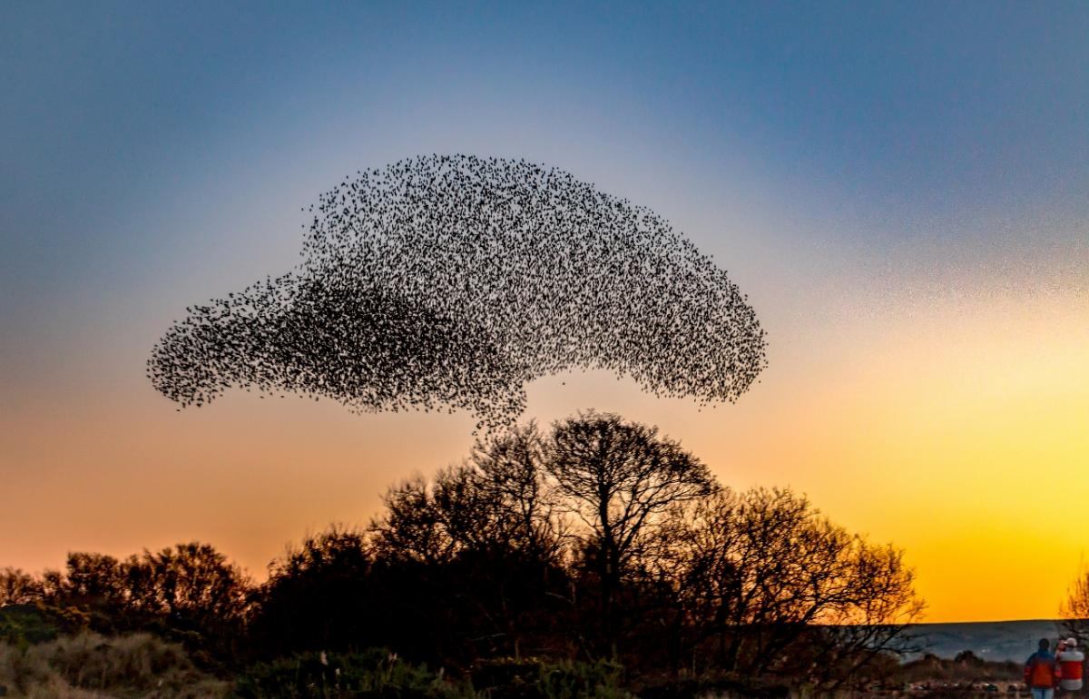
Collective Impact + Adaptive Management
Photo: www.burnmouthecho.com
Notes:
Nothing exemplifies the concept of “focused coordination and rapid adaptation” like a starling murmuration . When it all comes together it’s like a higher form of consciousness. It’s perhaps not unlike a brain with a gazillion synapses. The connectivity is hard to fathom but appreciable.

Slide 57
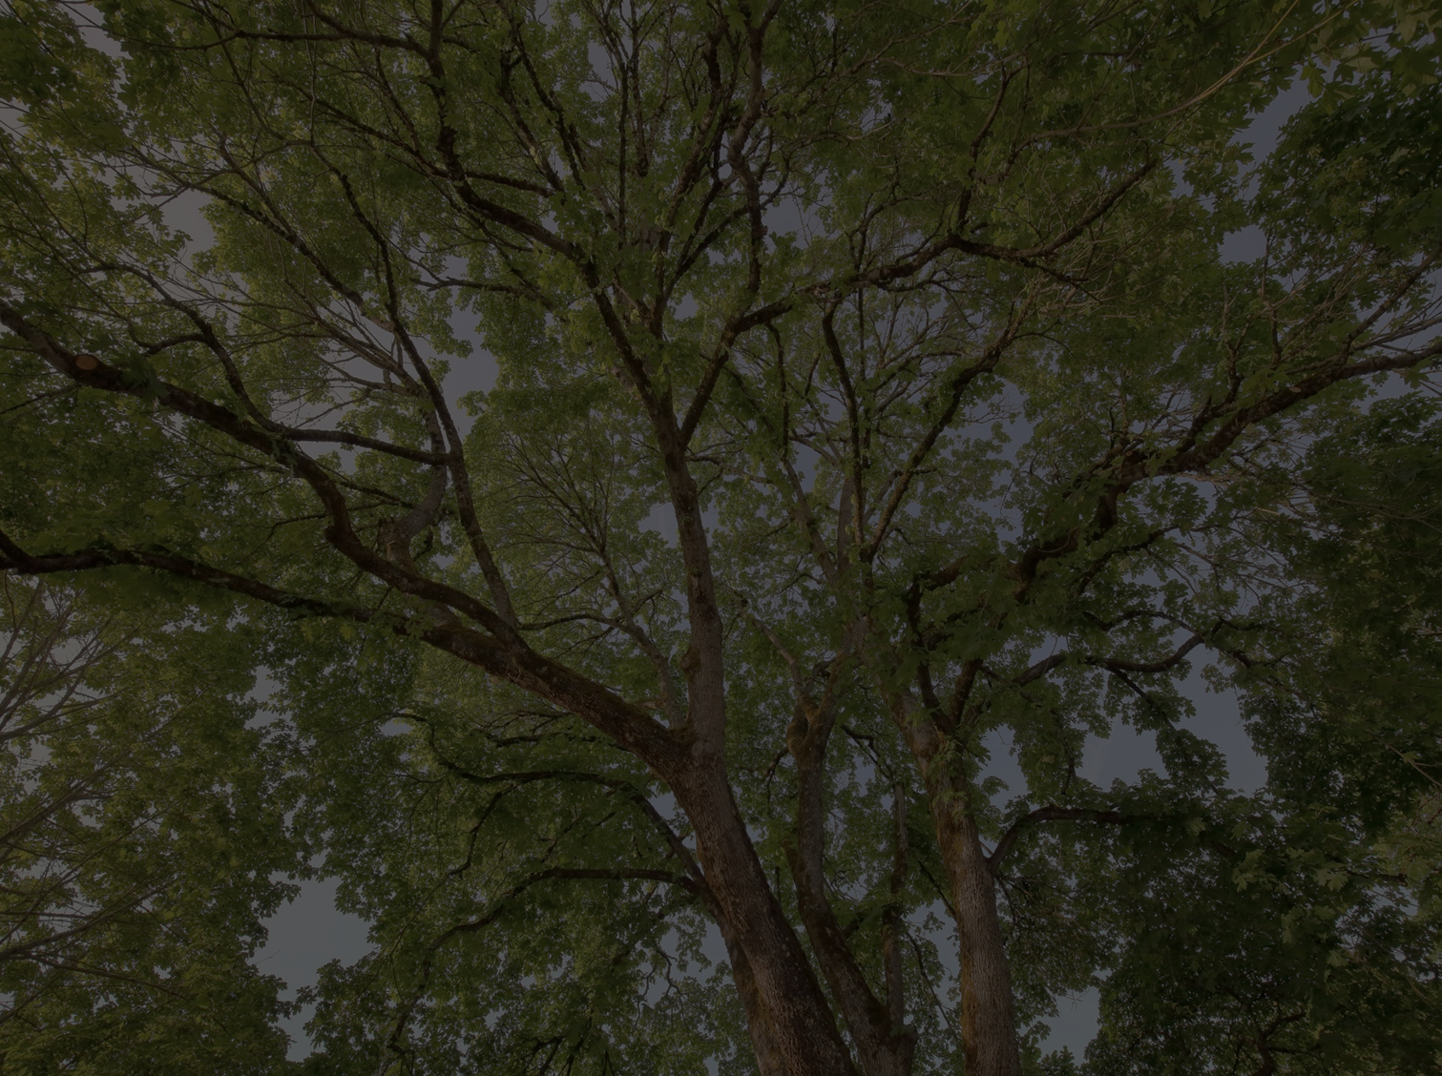
Summary

Slide 58
Summary
GI is one of the best tools we have for fighting social, ecological, and economic fragmentation and collapse in our communities

Slide 59
Summary
GI is one of the best tools we have for fighting social, ecological, and economic fragmentation and collapse in our communities
When planned, executed and maintained properly, GI has the potential to connect people, places, and essential processes

Slide 60
Summary
GI is one of the best tools we have for fighting social, ecological, and economic fragmentation and collapse in our communities
When planned, executed and maintained properly, GI has the potential to connect people, places, and essential processes
In order for GI to be successful, we need to collaborate at all
levels and throughout various sectors; we must be well-organized, and well-adapted to changing conditions

Slide 61
Summary
GI is one of the best tools we have for fighting social, ecological, and economic fragmentation and collapse in our communities
When planned, executed and maintained properly, GI has the potential to connect people, places, and essential processes
In order for GI to be successful, we need to collaborate at all
levels and throughout various sectors; we must be well-organized, and well-adapted to changing conditions
We need to break out of our respective silos; researchers, GI managers and field staff all need to share their knowledge/insights

Slide 62
Conclusion
Conclusion

Slide 63
Conclusion
Conclusion
“Realizing green infrastructure’s full potential requires coordination and collaboration across multiple boundaries – political, jurisdictional, agency, organizational, sectoral, disciplinary, professional, to name just a few.”
-Greening the Grey: An Institutional Analysis of Green Infrastructure for Sustainable Development in the US

Slide 64
Conclusion
Conclusion
“Realizing green infrastructure’s full potential requires coordination and collaboration across multiple boundaries – political, jurisdictional, agency, organizational, sectoral, disciplinary, professional, to name just a few.
The most significant challenge for advancing a robust and integrated form of green infrastructure may be one of leadership and collective action.”
-Greening the Grey: An Institutional Analysis of Green Infrastructure for Sustainable Development in the US

Slide 65
References:
Allen, W.J., Bosch, O.J.H, Kilvington, M.J., Harley, D. & Brown I. (2001) Monitoring and adaptive management: addressing social and organizational issues to improve information sharing. Natural Resources Forum 25(3):225-233. Accessed online at: http://citeseerx.ist.psu.edu/viewdoc/download?doi=10.1.1.570.9407&rep=rep1&type=pdf
Holling, C. S. (2001). Understanding the complexity of economic, ecological, and social systems. Ecosystems, 4(5), 390-405. Accessed online at: https://link.springer.com/article/10.1007/s10021-001-0101-5
Kania, J., & Kramer, M. (2011). Collective impact. Accessed online at: https://ssir.org/articles/entry/collective_impact
Kimmel, C., Robertson, D., Hull, R. B., Mortimer, M., & Wernstedt, K. (2013) Greening the Grey: An Institutional Analysis of Green Infrastructure for Sustainable Development in the US. Center for Leadership in Global Sustainability, Virginia Tech, 6.
Accessed online at: http://narc.org/wp-content/uploads/CLiGS-NARC_GI2013_final.pdf
McChrystal, G. S., Collins, T., Silverman, D., & Fussell, C. (2015). Team of teams: New rules of engagement for a complex world. Penguin.

Slide 66
Thanks for Your Time and Attention!
I Look Forward to Your Comments & Questions
Photo: Eric DeBord

